Slide 1
Book shop management system
OBJECT ORIENTED PROGRAMMING
Name : Sailee Kadam
College : VIT, Pune

Slide 2
Introduction
This software is developed to maintain records of books. The purpose of this software is to manage the books in the bookshop.
It includes the features like adding new book , showing the list of available books, check the particular book is available or not, update the book , and delete the book if not required .
It features are familiar and well thought-out.
The software keeps track of all the information about the books and their complete details.

Slide 3
Ide used
Code::Blocks is a free, open-source cross-platform IDE that supports multiple compilers including GCC, Clang and Visual C++. It is developed in C++ using wxWidgets as the GUI toolkit. Using a plugin architecture, its capabilities and features are defined by the provided plugins.

Slide 4
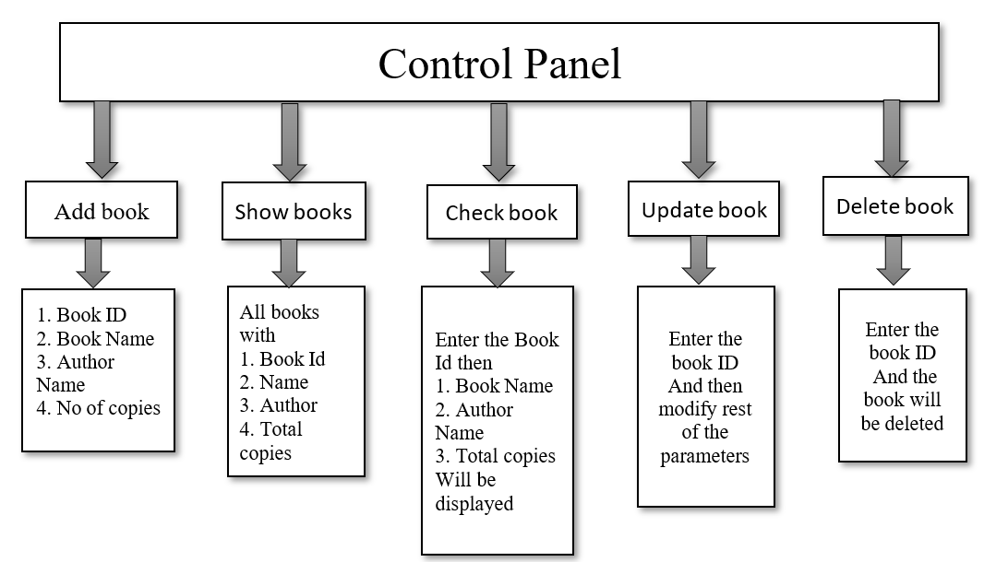
Block diagram

Slide 5
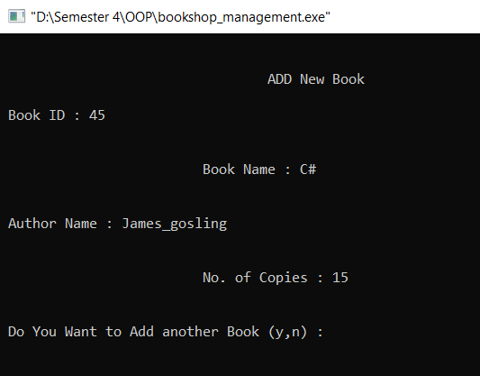
results
1) ADD BOOK

Slide 6
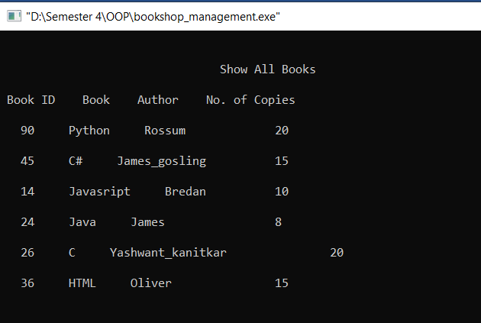
2) DISPLAY BOOK

Slide 7
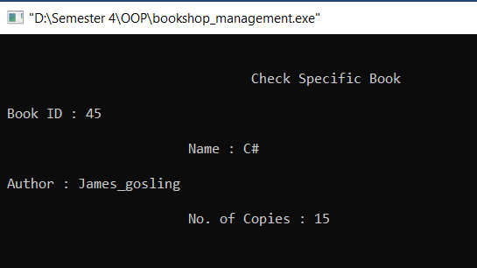
3)CHECK SPECIFIC BOOK

Slide 8
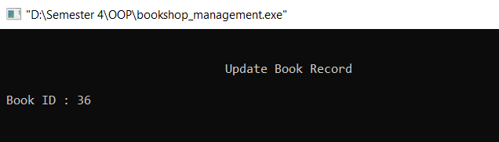
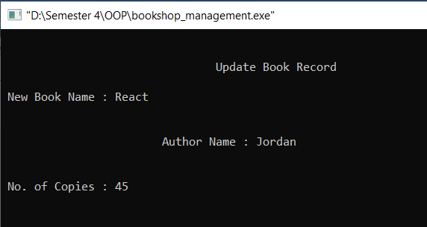
4) UPDATE BOOK

Slide 9
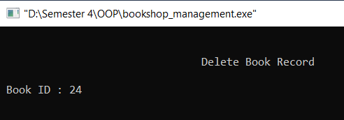
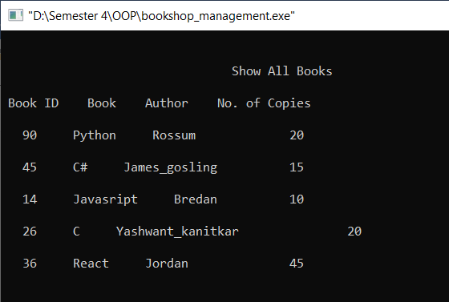
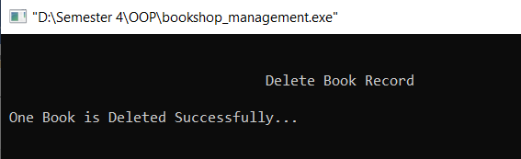
5) DELETE BOOK
Book of ID 24 deleted

Slide 10
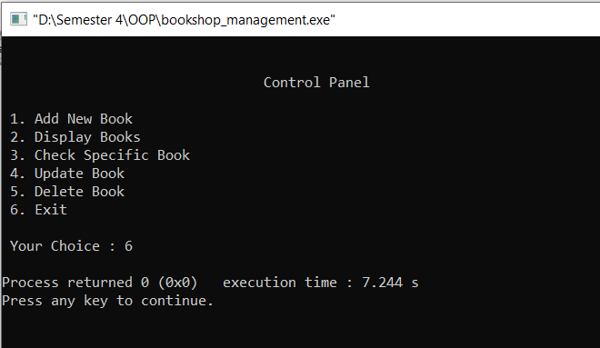
6) Exit

Slide 11
Future scope
This software can be easily implemented under various situations.
Any education institute can make use of it for providing information about author, content of the available books in their library.
Modifications can be easily done according to requirements and when necessary.
It can be used in any type of Book Shop for managing all the sales and purchased activities and managing the data records related to Books.

Slide 12
conclusion
The bookshop Management System allows the user to store the book details.
This software allows storing the details of all the data related to library.
The implementation of the system will reduce data entry time and provide readily calculated reports.

Slide 13
references
https://www.codewithc.com/bookshop-management-system-project-in-c/
https://www.scribd.com/doc/297789450/Book-Shop-Management-System-SYNOPSIS
https://www.ijraset.com/fileserve.php?FID=6570
https://www.academia.edu/30503188/ONLINE_BOOKSTORE_MANAGEMENT_SYSTEM

